Slide 1




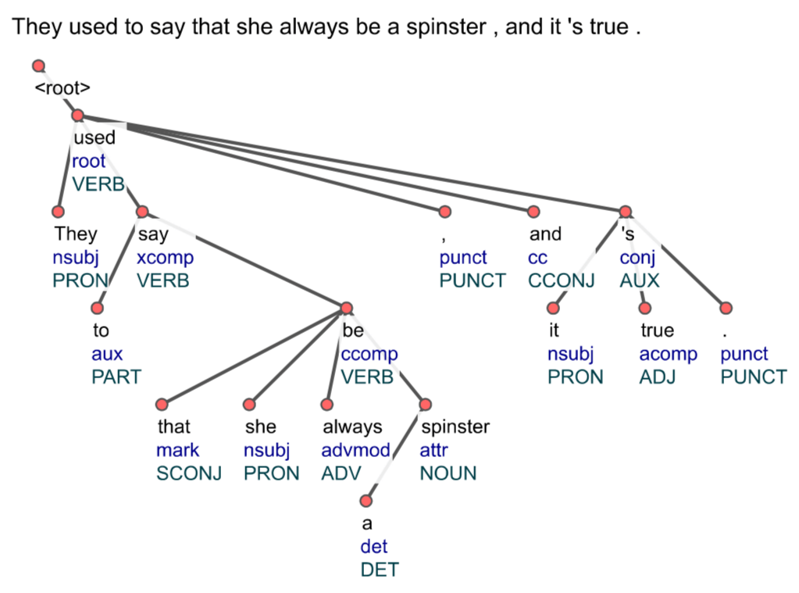
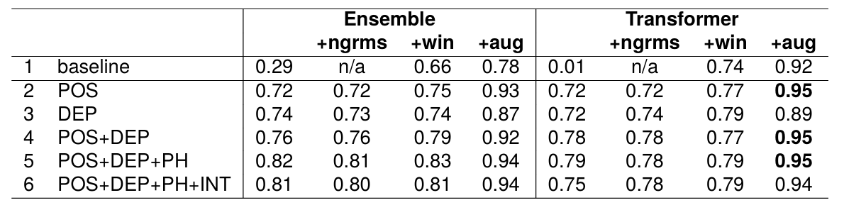
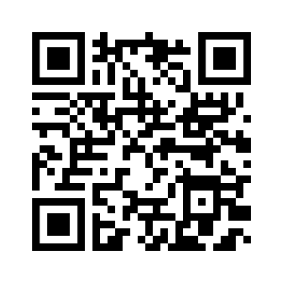
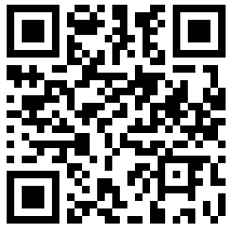
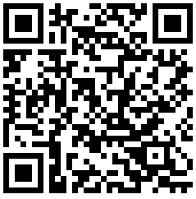
Leveraging syntactic dependencies in disambiguation: the case of African American English
Wilermine Previlon¹, Alice Rozet¹, Jotsna Gowda¹, William Dyer¹, Sarah Moeller¹, & Kevin Tang^{1, 2}
¹ Department of Linguistics, University of Florida
² Department of English Language and Linguistics, Institute of English and American Studies, Faculty of Arts and Humanities, Heinrich Heine University Düsseldorf
{wprevilon, arozet, jotsna.gowda, wgdyer, smoeller}@ufl.edu, kevin.tang@hhu.de
Introduction
Linguistic Analysis
Conclusion
Habitual be is an African American English (AAE) feature indicating recurring action.
AAE: I be in my office by 7:30
MAE: ‘I am usually in my office by 7:30’
AAE lacks annotated data, resulting in lower performance of NLP tools.
Increasing annotated data improves performance however manual annotation is expensive.
Dependency syntax analysis reveals 2 structures frequently related to habitual be:
Models informed by linguistic pattens of AAE outperformed those that were not
Linguistic information improves NLP performance for low resource languages like AAE
Further Direction
A detailed analysis of the salience of each syntactic pattern identified can inform the grammatical description of AAE
We are now working to conduct similar research on other AAE features such as multiple negation, person number agreement, and null copula.
Objective
Can linguistic information be used to enhance classification of African American English’s habitual be?
(1) be has a POS tag of AUX and its head has a POS tag of VERB
(2) be has a POS tag of VERB
Methodology
Results
References
Analyzed 250 sentences from African American oral histories
Trained an ensemble classical machine learning model and a Transformer model on linguistic structures
Use k-fold cross validation to rotate the training and test sets for improved model accuracy
Predicted sentences as habitual or non-habitual
Experimented with varying amounts of linguistic information to assess impact on classification rate.
Demszky, D., Sharma, D., Clark, J., Prabhakaran, V., & Eisenstein, J. (2021). Learning to Recognize Dialect Features. In K. Toutanova, A. Rumshisky, L. Zettlemoyer, D. Hakkani-Tur, I. Beltagy, S. Bethard, R. Cotterell, T. Chakraborty, & Y. Zhou (Eds.), Proceedings of the 2021 Conference of the North American Chapter of the Association for Computational Linguistics: Human Language Technologies (pp. 2315–2338). Association for Computational Linguistics. https://doi.org/10.18653/v1/2021.naacl-main.184
Fasold, R. W. (1969). Tense and the Form Be in Black English. Language, 45(4), 763–776. https://doi.org/10.2307/412334
Green, L. J. (2002). African American English: A linguistic introduction.
Magueresse, A., Carles, V., & Heetderks, E. (2020). Low-resource Languages: A Review of Past Work and Future Challenges (arXiv:2006.07264). arXiv. http://arxiv.org/abs/2006.07264
Masis, T., Neal, A., Green, L., & O’Connor, B. (2022). Corpus-Guided Contrast Sets for Morphosyntactic Feature Detection in Low-Resource English Varieties. Proceedings of the First Workshop on NLP Applications to Field Linguistics, 11–25. https://aclanthology.org/2022.fieldmatters-1.2
Classification of the habitual class. F1-scores averaged over 10 folds.
Discussion
Preprint
Video Presentation
Code
Data set | Habitual | Non-Habitual
Analysis | 132 | 118
Training | 465 | 3610
Testing | 52 | 402
Baseline ensemble only achieved a 0.29 F₁-score for habitual be.
Combining all syntactic and grammatical rules achieved the highest classification rate with a 0.83 F₁-score for the habitual class and 0.96 F₁-score overall
This work has been supported by the National Endowment for Humanities: #PW-277433-21 ($350,000): `Reanimating African American Oral Histories of the Gulf South: Tailoring Education and Research through Natural Language Understanding
Notes:
Hello, I’m Wilermine Previlon, a senior studying Linguistics at the University of Florida. African American English, a language spoken by Black people in the US, is understudied within artificial intelligence (AI). This contributes to lower performance on AAE, resulting in linguistic discrimination on social media, in education, and within the legal system. Increasing the amount of annotated data has been proven to increase performance however manually annotating data is time consuming and expensive. This study aims to address this issue by leveraging the unique linguistic features of AAE to create a classification model that will automatically annotate for its features within a corpus. We focus on AAE’s habitual be which is lexically identical to the more familiar be, however it indicates a reoccurring action. (ex: I be going shopping means I shop often/regularly). We first examine a corpus of 250 sentences from an African American oral history archive to determine linguistic structures that correlate to either the habitual or non-habitual be. These syntactic structures, along with linguistic information from previous research, were fed as Boolean rules into both an ensemble and transformer text classification model. We found that feeding in the most minimal linguistic information resulted in a [say how many points it improved by instead]

Slide 2

Leveraging Linguistic Information to Automatically Annotate African American English
Wilermine Previlon¹, Alice Rozet¹, Jotsna Gowda¹, Alexis Davis¹, Sarah Moeller¹, & Kevin Tang^{1, 2}
¹ Department of Linguistics, University of Florida
² Department of English Language and Linguistics, Institute of English and American Studies, Faculty of Arts and Humanities, Heinrich Heine University Düsseldorf
{wprevilon, arozet, jotsna.gowda, davisa2, smoeller}@ufl.edu, kevin.tang@hhu.de
Introduction
Linguistic Analysis
Discussion
Habitual be is an African American English (AAE) feature indicating recurring action.
AAE: I be in my office by 7:30
MAE: ‘I am usually in my office by 7:30’
AAE lacks annotated data, resulting in lower performance of natural language processing tools.
Increasing annotated data improves performance however manual annotation is expensive.
Dependency syntax analysis reveals 2 structures frequently related to habitual be:
Baseline ensemble only achieved a 0.29 F₁-score for habitual be.
Combining all of our syntactic and grammatical rules achieved the highest classification rate with a 0.83 F₁-score for the habitual class and 0.96 F₁-score overall
Conclusion
Objective
Models informed by linguistic pattens of AAE outperformed those that were not
Linguistic information improves NLP performance for low resource languages like AAE
Can linguistic information be used to enhance classification of African American English’s habitual be?
(1) be has a POS tag of AUX and its head has a POS tag of VERB
Further Direction
Methodology
A detailed analysis of the importance of each syntactic pattern identified can inform the grammatical description of AAE
We are now working to conduct similar research on other AAE features such as multiple negation, person number agreement, and null copula.
Analyzed 250 sentences from African American oral histories
Trained an ensemble classical machine learning model and a Transformer model on linguistic structures
Use k-fold cross validation to rotate the training and test sets for improved model accuracy
Predicted sentences as habitual or non-habitual
Experimented with varying amounts of linguistic information to assess impact on classification rate.
(2) be has a POS tag of VERB
References
Results
Demszky, D., Sharma, D., Clark, J., Prabhakaran, V., & Eisenstein, J. (2021). Learning to Recognize Dialect Features. In K. Toutanova, A. Rumshisky, L. Zettlemoyer, D. Hakkani-Tur, I. Beltagy, S. Bethard, R. Cotterell, T. Chakraborty, & Y. Zhou (Eds.), Proceedings of the 2021 Conference of the North American Chapter of the Association for Computational Linguistics: Human Language Technologies (pp. 2315–2338). Association for Computational Linguistics. https://doi.org/10.18653/v1/2021.naacl-main.184
Fasold, R. W. (1969). Tense and the Form Be in Black English. Language, 45(4), 763–776. https://doi.org/10.2307/412334
Green, L. J. (2002). African American English: A linguistic introduction.
Magueresse, A., Carles, V., & Heetderks, E. (2020). Low-resource Languages: A Review of Past Work and Future Challenges (arXiv:2006.07264). arXiv. http://arxiv.org/abs/2006.07264
Masis, T., Neal, A., Green, L., & O’Connor, B. (2022). Corpus-Guided Contrast Sets for Morphosyntactic Feature Detection in Low-Resource English Varieties. Proceedings of the First Workshop on NLP Applications to Field Linguistics, 11–25. https://aclanthology.org/2022.fieldmatters-1.2
Data set | Habitual | Non-Habitual
Analysis | 132 | 118
Training | 465 | 3610
Testing | 52 | 402
Classification of the habitual class. F1-scores averaged over 10 folds.
Notes:
Hello, I’m Wilermine Previlon, a senior studying Linguistics at the University of Florida. African American English, a language spoken by Black people in the US, is understudied within artificial intelligence (AI). This contributes to lower performance on AAE, resulting in linguistic discrimination on social media, in education, and within the legal system. Increasing the amount of annotated data has been proven to increase performance however manually annotating data is time consuming and expensive. This study aims to address this issue by leveraging the unique linguistic features of AAE to create a classification model that will automatically annotate for its features within a corpus. We focus on AAE’s habitual be which is lexically identical to the more familiar be, however it indicates a reoccurring action. (ex: I be going shopping means I shop often/regularly). We first examine a corpus of 250 sentences from an African American oral history archive to determine linguistic structures that correlate to either the habitual or non-habitual be. These syntactic structures, along with linguistic information from previous research, were fed as Boolean rules into both an ensemble and transformer text classification model. We found that feeding in the most minimal linguistic information resulted in a [say how many points it improved by instead]

Slide 3
Leveraging Linguistic Information to Automatically Annotate African American English
Wilermine Previlon¹, Alice Rozet¹, Jotsna Gowda¹, Alexis Davis¹, Sarah Moeller¹, & Kevin Tang^{1, 2}
¹ Department of Linguistics, University of Florida
² Department of English Language and Linguistics, Institute of English and American Studies, Faculty of Arts and Humanities, Heinrich Heine University Düsseldorf
{wprevilon, arozet, jotsna.gowda, davisa2, smoeller}@ufl.edu, kevin.tang@hhu.de
Introduction
Linguistic Analysis
Discussion
African American English exhibits distinct linguistic features, such as habitual be indicating reoccurring activities
AAE: I be in my office by 7:30
MAE: ‘I am usually in my office by 7:30’
AAE lacks annotated data, resulting in lower performance of natural language processing tools.
Increasing annotated data improves performance however manual annotation is expensive.
Part-of-speech tag analysis comes from Santiago et al. (2022)
Dependency syntax analysis reveals 2 structures frequently related to habitual be:
Baseline ensemble only achieved a 0.29 F₁-score for habitual be.
Combining part-of-speech structure, dependency syntax, and post-hoc rules with simple part-of-speech window achieved the highest classification rate with a 0.83 F₁-score for the habitual class
Conclusion
Models informed by linguistic pattens of AAE outperformed those that were not
Linguistic information improves NLP performance for low resource languages like AAE
Objective
Can we use the unique structures of AAE to create a model that automatically annotates habitual be instances in a corprus and improves on previous research?
(2) be has a POS tag of VERB
Further Direction
(1) be has a POS tag of AUX and its head has a POS tag of VERB
A detailed analysis of the importance of each syntactic pattern identified can inform the grammatical description of AAE
Our model analyzes sentences with one be, performance on sentences with multiple be’s is left for future work.
Methodology
Analyze 250 spaCy-parsed sentences from Joel Buchanan archive to identify habitual and non-habitual be structures.
Train an ensemble of classical machine learning model and a Transformer model on linguistic structures
Predict sentences as habitual or non-habitual.
Experiment with varied amounts of linguistic information to assess impact on habitual be classification rate
Results
References
Demszky, D., Sharma, D., Clark, J., Prabhakaran, V., & Eisenstein, J. (2021). Learning to Recognize Dialect Features. In K. Toutanova, A. Rumshisky, L. Zettlemoyer, D. Hakkani-Tur, I. Beltagy, S. Bethard, R. Cotterell, T. Chakraborty, & Y. Zhou (Eds.), Proceedings of the 2021 Conference of the North American Chapter of the Association for Computational Linguistics: Human Language Technologies (pp. 2315–2338). Association for Computational Linguistics. https://doi.org/10.18653/v1/2021.naacl-main.184
Fasold, R. W. (1969). Tense and the Form Be in Black English. Language, 45(4), 763–776. https://doi.org/10.2307/412334
Green, L. J. (2002). African American English: A linguistic introduction.
Magueresse, A., Carles, V., & Heetderks, E. (2020). Low-resource Languages: A Review of Past Work and Future Challenges (arXiv:2006.07264). arXiv. http://arxiv.org/abs/2006.07264
Masis, T., Neal, A., Green, L., & O’Connor, B. (2022). Corpus-Guided Contrast Sets for Morphosyntactic Feature Detection in Low-Resource English Varieties. Proceedings of the First Workshop on NLP Applications to Field Linguistics, 11–25. https://aclanthology.org/2022.fieldmatters-1.2
The models’ performance on the habitual/non-habitual disambiguation of “be” using the weighted average F1-scores by the number of true instances for each class.
Data set | Habitual | Non-Habitual
Analysis | 132 | 118
Training | 465 | 3610
Testing | 52 | 402
Classification of the habitual class. F1-scores averaged over 10 folds. See the caption of Table 2 for explanations of the table.
Notes:
Hello, I’m Wilermine Previlon, a senior studying Linguistics at the University of Florida. African American English, a language spoken by Black people in the US, is understudied within artificial intelligence (AI). This contributes to lower performance on AAE, resulting in linguistic discrimination on social media, in education, and within the legal system. Increasing the amount of annotated data has been proven to increase performance however manually annotating data is time consuming and expensive. This study aims to address this issue by leveraging the unique linguistic features of AAE to create a classification model that will automatically annotate for its features within a corpus. We focus on AAE’s habitual be which is lexically identical to the more familiar be, however it indicates a reoccurring action. (ex: I be going shopping means I shop often/regularly). We first examine a corpus of 250 sentences from an African American oral history archive to determine linguistic structures that correlate to either the habitual or non-habitual be. These syntactic structures, along with linguistic information from previous research, were fed as Boolean rules into both an ensemble and transformer text classification model. We found that feeding in the most minimal linguistic information resulted in a [say how many points it improved by instead]

Slide 4
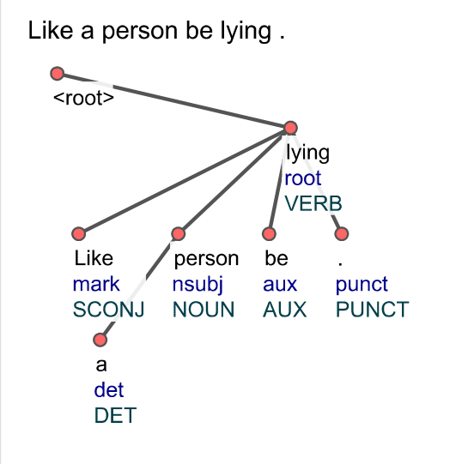
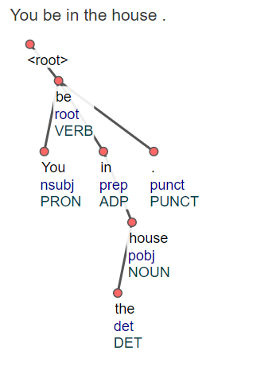
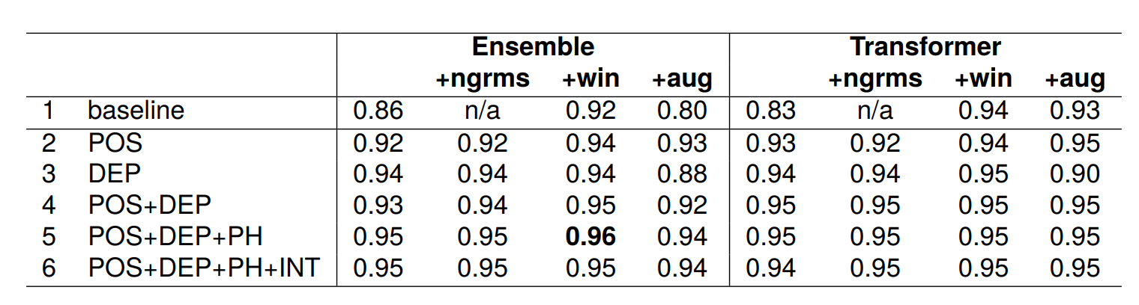
Leveraging Linguistic Information to Automatically Annotate African American English
Authors
University of Florida, Department of Linguistics
BACKGROUND
1. Examined linguistic literature for current grammatical descriptions of AAE
2. Analyzed 250 parsed sample sentences to determine common patterns in the syntax of both habitual and non-habitual be.
3. Translated patterns into Boolean rules that act as the input for classification models
SYNTACTIC PARSING
African American English (AAE) is understudied and under-computerized, leading to lower performance of natural language processing tools.
NLP underperformance can lead to discrimination on social media, ungrammatical language generations and inaccurate transcriptions, among others.
Increasing the amount of annotated training data improves NLP performance on AAE, but manual annotation is time consuming, expensive, and requires a level of expertise that is not always available.
Can we leverage the unique linguistic features of AAE to build a classification model that automatically annotates instances of AAE within a corpus?
SynPar3: be has a part-of-speech tag of AUX and its head has a part-of-speech tag of VERB
4. Conducted various experiments to determine the role additional syntactic information plays on classification rate.
5. Found classification models informed by AAE's unique syntactic information consistently outperformed those that did not
METHOD
Approach: We utilize linguistic knowledge and our own analysis of AAE data to create Boolean rules that identify linguistic structures associated with habitual and non-habitual uses of be
Data Handling: Data comes from two oral history corpora: Joel Buchanan Archive and the Corpus of African American language (CORAAL). Each sentence containing be is treated as a data point. Sentences with more than one be are omitted. This disambiguation task is approached as a text classification problem.
Model Training: Classical machine learning models and the Transformer model are trained using the Boolean rules as input. We employ an ensemble of classical models and implement modifications to the Transformer for low-resource tasks.
Experiments: We conduct several experiments incorporating unique syntactic features of AAE's habitual "be" construction. These experiments evaluate the impact of various linguistic features on habitual be disambiguation, such as part-of-speech patterns, dependency patterns, post-hoc rules, and interaction of patterns. Additionally, we employ data augmentation to address imbalanced training data.
EXPERIMENTS
We conduct several experiments incorporating unique syntactic features of AAE's habitual "be" construction. These experiments evaluate the impact of various linguistic features on habitual be disambiguation, such as part-of-speech patterns, dependency patterns, post-hoc rules, and interaction of patterns. Additionally, we employ data augmentation to address imbalanced training data.
RESULTS
SynPar4: be has a part-of-speech tag of VERB
The baseline Ensemble with only n-grams achieved a weighted average F₁-score of .86 yet only .29 F₁-score for habitual be.
Simple Part-of-Speech window achieved a .66 F₁-score on the Ensemble and .74 F₁-score on the Transformer
Combining part-of-speech structure, dependency syntax, and post-hoc rules with simple part-of-speech window achieved the highest classification rate with a 0.83 F₁-score.
REFERENCES
Demszky, D., Sharma, D., Clark, J., Prabhakaran, V., & Eisenstein, J. (2021). Learning to Recognize Dialect Features. In K. Toutanova, A. Rumshisky, L. Zettlemoyer, D. Hakkani-Tur, I. Beltagy, S. Bethard, R. Cotterell, T. Chakraborty, & Y. Zhou (Eds.), Proceedings of the 2021 Conference of the North American Chapter of the Association for Computational Linguistics: Human Language Technologies (pp. 2315–2338). Association for Computational Linguistics. https://doi.org/10.18653/v1/2021.naacl-main.184
Fasold, R. W. (1969). Tense and the Form Be in Black English. Language, 45(4), 763–776. https://doi.org/10.2307/412334
Green, L. J. (2002). African American English: A linguistic introduction.
Magueresse, A., Carles, V., & Heetderks, E. (2020). Low-resource Languages: A Review of Past Work and Future Challenges (arXiv:2006.07264). arXiv. http://arxiv.org/abs/2006.07264
Masis, T., Neal, A., Green, L., & O’Connor, B. (2022). Corpus-Guided Contrast Sets for Morphosyntactic Feature Detection in Low-Resource English Varieties. Proceedings of the First Workshop on NLP Applications to Field Linguistics, 11–25. https://aclanthology.org/2022.fieldmatters-1.2
DISCUSSION
Classification models informed by the syntactic patterns of African American English consistently outperformed models that did not in the case of the habitual be.
Our work highlights the importance of leveraging existing linguistic literature and expert knowledge to develop NLP systems for low resource languages like AAE.
Notes:
Baseline (+ngrams): Model trained on unigrams and bigrams without additional syntactic information
Simple Part-Of-Speech Window (+win): Model trained on tags of an eight-word window surrounding be were extracted
Part-of-Speech (POS): Model trained on Boolean representations of POS patterns proposed by Santiago et al. (2022) that correlated to non-habitual instances.
Dependency Patterns (DEP): Model trained on Boolean representations of syntactic patterns we identified during our analysis.
Post-hoc Rules (PH): Additional rules found after performing an error analysis reviewing incorrect predictions from the combined POS+DEP models.
Interaction of Patterns (INT): Certain interactions and relationships that hold between the rules. For example, when a sentence has not been tagged by an POS rule, it is much more likely to be habitual than non-habitual
Data Augmentation: Replicated Santiago et al. (2022)’s data augmentation methodology to reduce bias of an imbalanced training set.

